Slide 1
Introduction to HRM:
HRM, organizational performance and employee outcomes
6CCYM339
Session 1/10

Slide 2
Session Outline
What is HRM? A brief historical overview
Contemporary HRM
Strategic HRM
  The universalist perspective
  The contingency perspective
  The configurational perspective
HRM & Performance

Slide 3
What is HRM?
‘The function which is related to the understanding, maintenance, development, effective employment, and integration of the potential in the resource of ‘people’’ (Blake, 1961)
‘HRM comprises a set of policies designed to maximize organizational integration, employee commitment, flexibility and quality of work.’ (Guest, 1987)
‘The management of work and people towards desired ends’ (Boxall et al., 2007)

Slide 4
Do we need HRM in our organizations?
Freeman and Rogers (1999) conducted a national survey in the US in the mid-1990s and found that 30% of American workers were employed in firms that had no formal HRM department.
Some people have questioned the rationale for investing in HRM relative to other organizational investments, such as a new production technologies or advertising campaigns
However,
No organization can survive without making a reasonable attempt at organizing work and managing people
“To wish HRM away is to wish away all but the very smallest of firms” (Boxall, Purcell & Wright, 2007)

Slide 5
A (very) brief history of HRM
  Industrial Welfare in the last quarter of the XIX century
  Personnel Management and scientific managment
  Contemporary HRM

Slide 6
The last quarter of the XIX century – the emergence of industrial welfare work
  Companies relied on the market to set pay rates
  Motivation was achieved through the threat of termination
  Discipline was imposed by the owner or formen
In the last decade of the XIX century a number of companies started to provide a variety of workplace and family amenities for their employees, such as:
lunch rooms
medical care
Housing
Recreational programs
Libraries
etc…
First type of HRM structure
Welfare secretary (usually a woman or social workers)
Employment office
  Managed by lower level office clerks
  Administrative taks such as hiring, payroll, record keeping

Slide 7
  The emergence of scientific managment and personnel managment
Next, you will watch a video about the principles of scientific management.
Try to identify the principles proposed by Taylor and Ford
See if you can identify how the implementation of those principles boosted the development of HR practices

Slide 8

  The emergence of scientific managment and personnel managment

Slide 9
The emergence of scientific managment and personnel managment
The widespread adoption of Taylor’s principles of scientific management boosted the development of HRM both as a scientific area and as an important function within the organizational structure
The principles of Scientific Management and HRM:
Workers should be scientifically sellected
Workers need to be trained to deliver
adequate performance
Workers should be paid according to their
individual performance
Personnel Management Departments:
Recruitment and selection
Training
Performance appraisal
Compensation

Slide 10
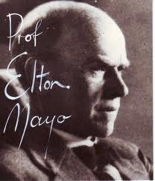
Elton Mayo – The human relations approach
Introduced a discussion about the role of human emotions in management through a number of experiments at the Hawthorne Factory of Western Electric
Next you will watch a video about some of the most famous experiments done at Hawthorne.
The lightening experiments (1924-1927)
Relay-assembly Room studies (1928-1929)
Note how the results of the experiments are surprising. Reflect
on the implications of the findings to managing people at work.
1880-1949

Slide 11

Elton Mayo – The human relations approach

Slide 12
The development of HRM
The key idea underpinning HRM is that organizations can gain higher productivity and performance by designing work and practicing management in ways that take into account that employees are people with psychological and social needs and aspirations
Old Employment Model
New Employment Model
Inflexible
High Conflict
Low Productivity
Flexible
Low Conflict
High Performance

Slide 13
What is distinctive about HRM?
(versus traditional personnel management)
The rising importance of strategic managment
  “Pattern of planned human resource deployments and activities intended to enable an organization to achieve its goals” (Kaufman, 2007)
An emphasis on high-performance and high-commitment work systems
  Adoption of sets of HR bundles
  A new role of Line managers
    Line managers’ commitment to HR values

Slide 14
The development of HRM also benefits from
The decline of union membership and union influence
    Opportunity to switch from defensive union avoidance and a pluralist collective bargaining approach of employment management to a more proactive and high-performance/high-commitment focused approach to HRM
Is inspired by the success of the Japanese industry in the 1970s-1980s
  Led to the widespread conviction that the Japanese HRM model, built on high performance practices such as participative management and extensive training, was closely associated with the competitive advantage Japanese carmakers achieved in the 1970s and 1980s

Slide 15
How is HRM changing?
Time spent on administrative tasks is decreasing and HRM’s role in supporting corporate strategy, changing attitudes, behavior and culture is increasing
People Management (attracting and retaining talent; Developing talent; Job design; Compensation)
Employee services (relocation; outplacements)
Employee and community relations (labour relations, labour law compliance)
Personnel records
Health & Safety (safety inspections; drugs testing)

Slide 16
Competitive environment, corporate strategy and HRM
Competitive environment
Fast changing consumer taste
Market segmentation
Uncertainty / Unpredictability
Short product life cycle
HRM should intervene at:
The formulation of the company’s strategy (e.g. analysing the external labour market market to ensure that the skills required to execute the strategy are available; analysing the strengths and weaknesses of the company’s HR to meet the strategy’s demands)
Developing control systems to ensure that employees are behaving according to the company’s strategy (eg. that employees are displaying appropriate behaviors towards costumers)
Organization
Mission
Strategy
Performance
Goals
b)
HRM policies and practices
a)

Slide 17
Strategic HRM (SHRM)
‘is the interface between HRM and strategic management’ (Boxall, 1996)
Key ideas:
‘Organizations adopting a particular strategy require HR practices that are different from those required by organizations adopting different strategies’
Organizations with ‘greater congruence between their HR strategies and their (business) strategies should enjoy superior performance’.
(Delery & Glick, 1996)

Slide 18
3 Perspectives on SHRM
The Universalist Perspective (Best Practice)
The Contingency Perspective (Best fit)
The Configurational Perspective (Bundling)

Slide 19
The Universalist Perspective
Implies that there exists a set of ‘best HRM practices’ that are positively associated with company performance
  Best practices:
  Employment Security
  Selectivity in recruitment
  High wages
  Incentive pay
  Employee ownership (stock plans)
  Information sharing
  Employee participation
  Self-managed teams
  Extensive training and development
  Job rotation and cross-training
  Symbolic egualitarianism
  Wage compression (low salary variation)
  Promotion from within
  Source: Pfeffer, 1998

Slide 20
The Universalist Perspective
  ISSUES
There are examples in every industries of successful companies with very different sets of management practices (Cappelli and Crocker-Hefter, 1996)
There seems to be an inconsistency between a belief in best practice and the resource-based view of the firm that focuses on the intangible assets, including HR, that allow the firm to do better than its competitors (Purcell, 1999)
  EVIDENCE
  This is the most widely tested and the most strongly supported perspective. Almost every study supports the best practice approach. Essentially, what they all show, either across industries or within a specific sector, is that the more of the high performance HRM practices that are used, the better the performance as indicated by productivity, labour turnover or financial indicators.
  (Guest, 1997)

Slide 21
The Contingency Perspective
Seeks to maximize fit between an organization’s HR policies and its strategy
This approach tends to assume that a particular response will always be superior given certain circumstances.
Is usually associated with strategic types described in the strategy literature (eg. Porter’s competitive strategies or Miles and Snow’s organizational types)

Slide 22
The Contingency Perspective
HR strategy | Competitive strategy (Porter)
 | Achieve competitive advantage through innovation | Achieve competitive advantage through quality | Achieve competitive advantage through cost-leadership
Resourcing Recruitment and retention | ?? | ?? | ??

Slide 23
The Contingency Perspective
HR strategy | Competitive strategy (Porter)
 | Achieve competitive advantage through innovation | Achieve competitive advantage through quality | Achieve competitive advantage through cost-leadership
Resourcing Recruitment and retention | Recruit and retain high quality people with innovative skills and a good track record in innovation | Use sophisticated selection procedures to recruit people who are likely to deliver quality and high levels of customer service | Develop core/periphery employment structures; recruit people who are likely to add value; if unavoidable, plan and manage downsizing humanely

Slide 24
The Contingency Perspective
  ISSUES
‘It is necessary to avoid falling into the trap of “contingent determinism” (ie claiming that the context absolutely determines the strategy). There is, or should be, room for making strategic choices.’ (Paawue, 2004)
  EVIDENCE
There is some support for this approach. Huselid (1995) has found that those organizations that link HRM practices to strategy report higher financial performance outcomes.
  (Guest, 1997)

Slide 25
The Configurational Perspective
Implies the existence of distinctive patterns or configurations – what are sometimes called ‘bundles’ – of practices and the key is to determine which are the most effective.
“Implicit in the notion of a ‘bundle’ is the idea that practices within bundles are interrelated and internally consistent, and that ‘more is better’ with respect to the impact on performance, because of the overlapping and mutually reinforcing effect of multiple practices” (McDuffie, 1995)

Slide 26
The Configurational Perspective
  ISSUES
‘The problem with the bundling approach is that of deciding what is the best way to relate different practices together.
There is no evidence that one bundle is generally better than another
  EVIDENCE
Mixed Support
Delaney and Huselid (1996) failed to find any positive impact for specific combinations of practices as opposed to the total number of HRM practices on organizational performance.
Delery and Doty (1996) found some support for the configurational approach in their study in the banking sector”.

Slide 27
Points to retain
There is empirical support for each of the three main approaches to SHRM but consistently stronger support for the best practice model
It is unwise to adopt ‘best practices’ without being certain that they fit with the organization’s context and strategy
Best fit HR strategies are useful as long as the organization avoids falling into the trap of ‘contingent determinism’
Improved performance can be achieved by ‘bundling’, adopting several HR practices that are inter-related and complementary of each other

Slide 28
Is there a link between HRM and organizational performance?

Slide 29
Let’s take a look at the evidence
The Future of Work Programme on HRM and Performance
Sponsored by the ESRC and CIPD
Based at University of London
Interviews, surveys and case studies
610 HR managers and 462 CEOs
Financial performance: 1996 – 2001
12 case studies in financial and pharmaceutical sectors

Slide 30
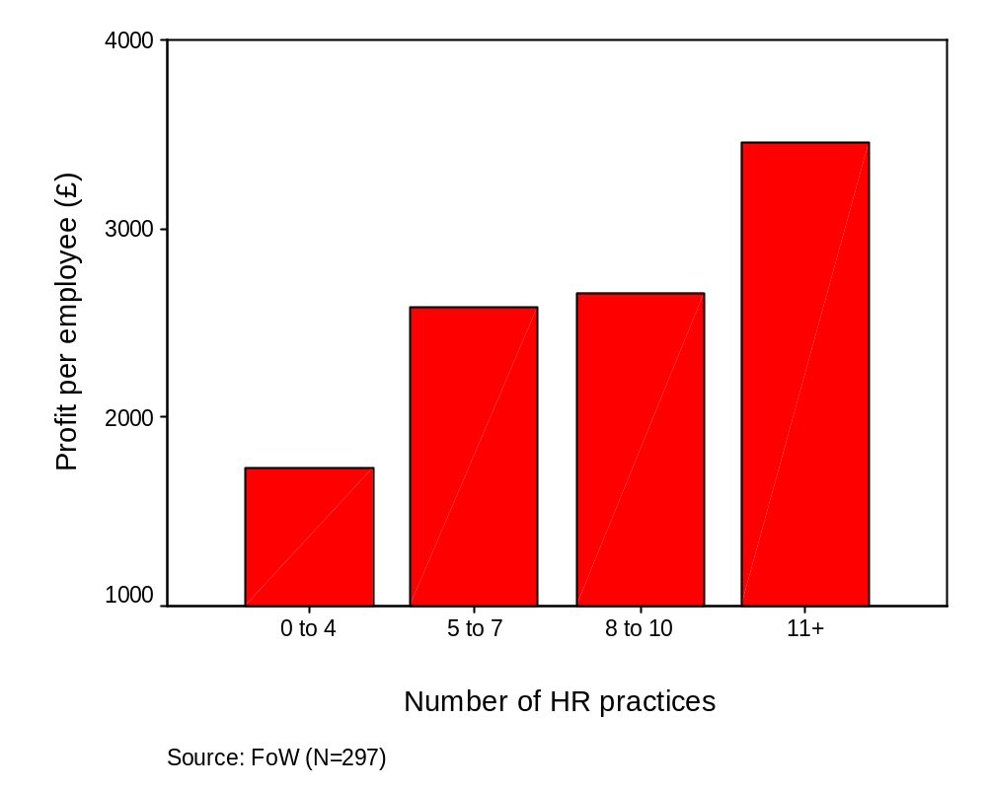
HR and profit per employee (UK)

Slide 31
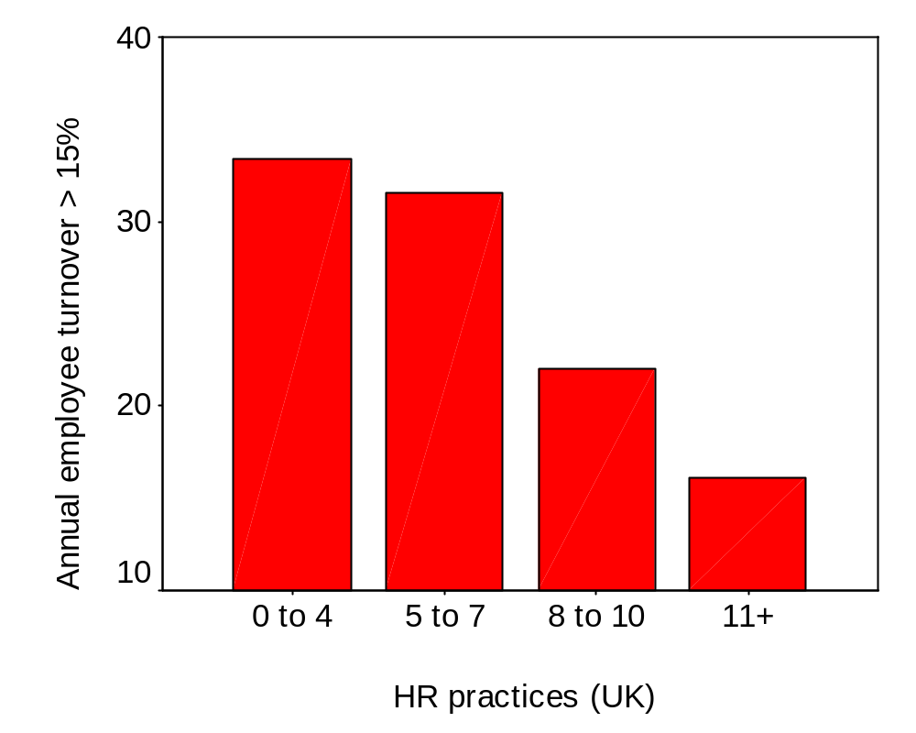
HRM and Labour Turnover (UK)

Slide 32
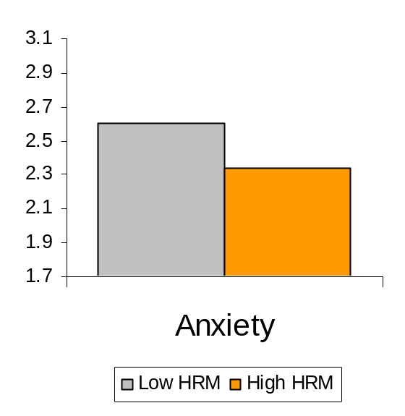
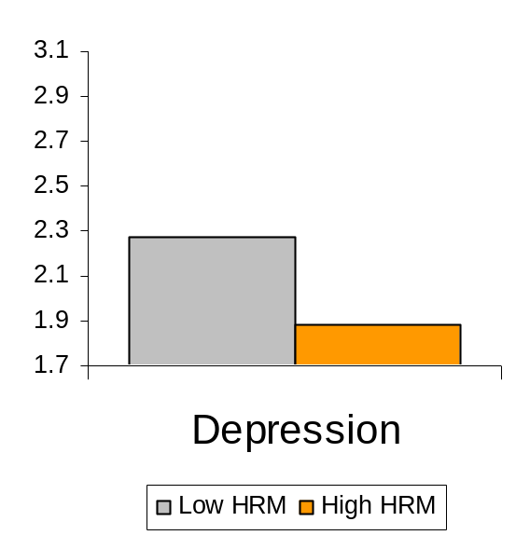
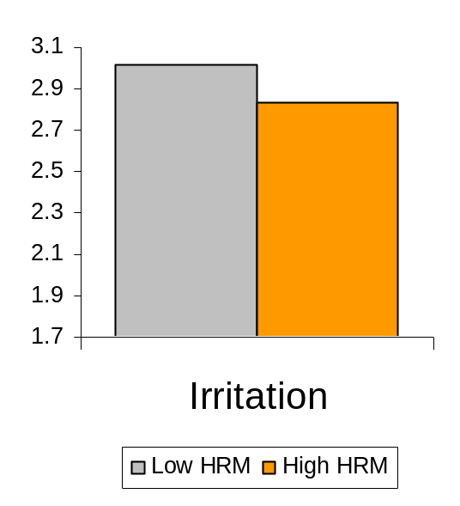
HRM and Employee Outcomes
HRM & Work-Related Well-being
(Psycones Study: Guest et al, 2006)

Slide 33
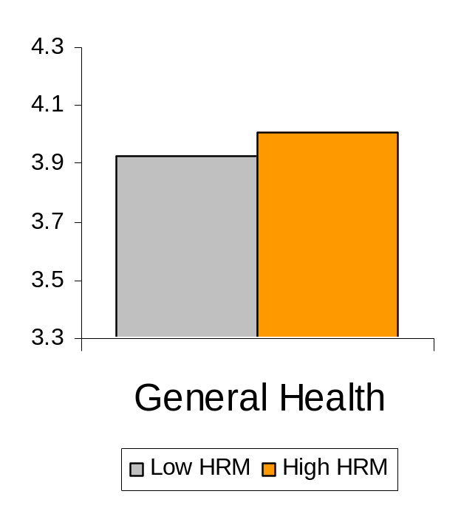
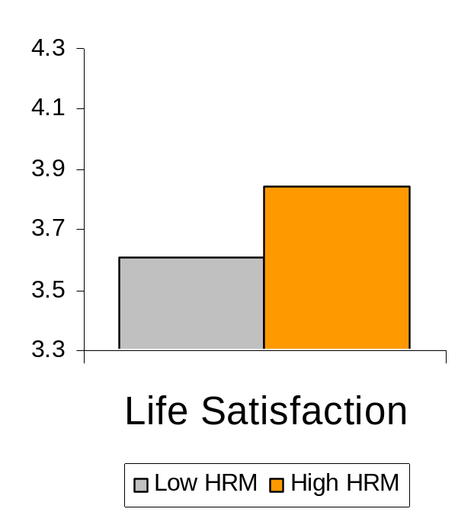
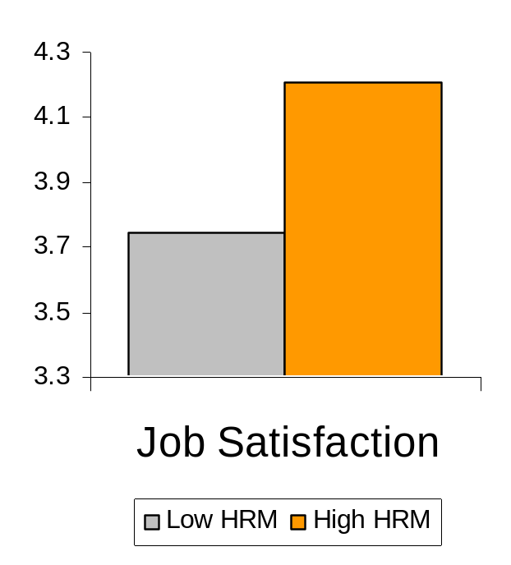
HRM and Employee Outcomes
HRM & Health & Satisfaction
(Psycones Study: Guest et al, 2006)

Slide 34
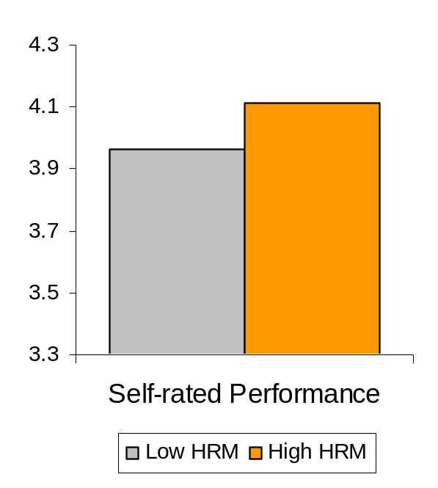
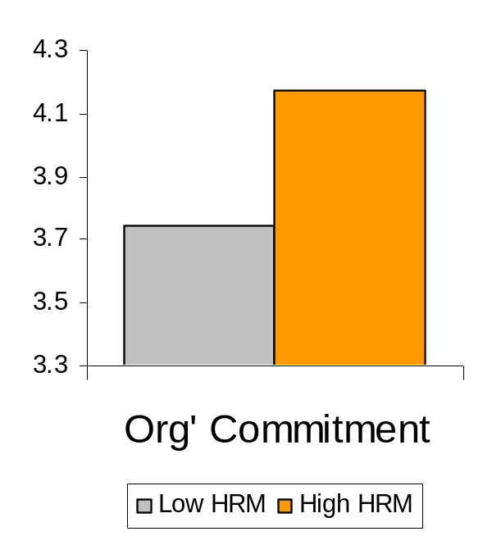
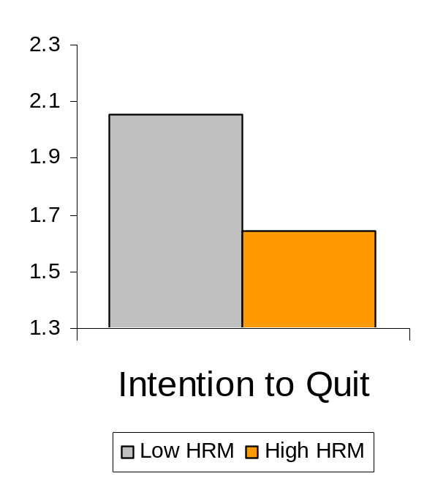
HRM and Employee Outcomes
HRM & Work Attitudes
(Psycones Study: Guest et al, 2006)

Slide 35
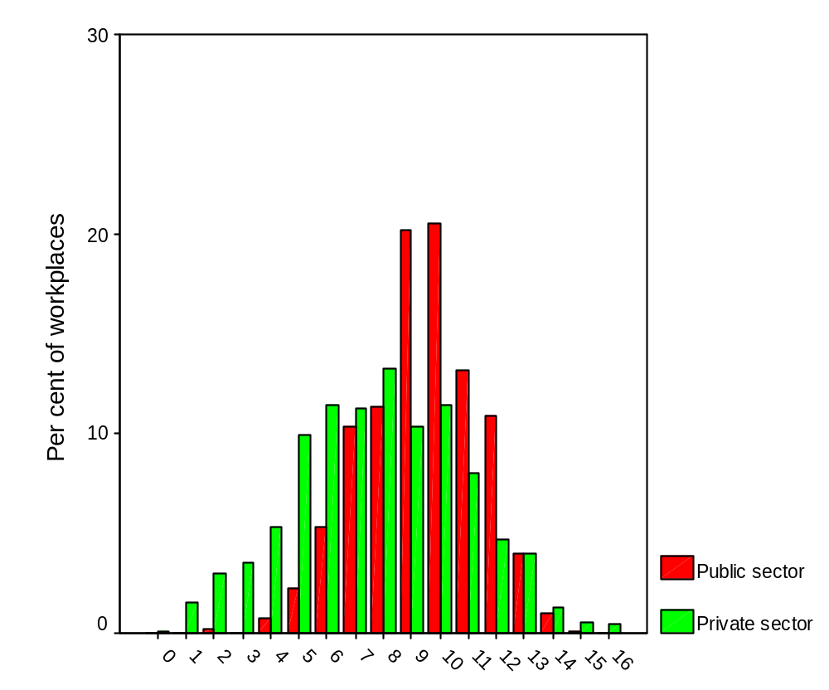
Adoption of HR practices (UK)
Number of HR practices in the public (N=546) and private sectors (N=1277)
WERS data

Slide 36
Why don’t organizations adopt more HR practices?
Not aware of the evidence/message
Don’t believe the message
Don’t believe it is relevant to them
Believe they already do enough
More important priorities
Sceptical of HR fad and fashions and gurus
Don’t know how to implement high commitment HR/where to start

Slide 37
General guidelines
There is consistent empirical support for the link between HRM and organizational performance;
There is support for each of the three main approaches to SHRM but consistently stronger support for the best practice model with its view that those organizations that use more high performance HRM practices report higher performance.
It is unwise to adopt ‘best practices’ without being certain that they fit with the organization’s context and strategy
Best fit HR strategies are useful as long as the organization avoids falling into the trap of ‘contingent determinism’
Improved performance can be achieved by ‘bundling’, adopting several HR practices that are inter-related and complementary of each other

Slide 38

Why is there a link between HRM and Performance?
HRM
Performance
AMO model (Abilities, Motivation, Opportunity to participate)
HR Climate (Bowen and Ostroff, 2004)
HR Attributions (Nishii, Lepak and Schneider, 2008)
HR implementation

Slide 39
The Study
Aims to replicate and extend the Nishii et al study but focusing on employee rather than organizational outcomes
Preliminary interviews identified five attributions and five core HR practices applied throughout the organization (Nishii et al also had five of each)
Study context: staff of an airline at Heathrow airport. Mix of customer service personnel and technical maintenance staff
All heavily unionised
Guest, D. and Rodrigues, R. (2014). HR Attributions, HR Implementation and Employee Well-being. Academy of Management Annual Meeting, 1-5 August, Philadelphia, PA.

Slide 40
The attributions
To enhance performance/productivity
To keep costs down
To promote employee well-being
To get the most out of employees
To comply with union requirements
The HR practices:training; job design; job security;
hiring choices; pay
Core question: what are the reasons why each
practice is applied?

Slide 41
Hypotheses
Attributions that HR practices introduced to improve well-being will be associated with higher well-being
Attributions that HR practices are introduced to control costs, intensify work and enhance productivity/performance will be associated with lower well-being
Attributions that HR practices will be introduced as a result of union compliance will be associated with higher well-being
Job type (white/blue collar) will moderate the union attributions

Slide 42
Procedure and Sample
  Data was collected via a questionnaire in the London headquarters of a large airline company
  Questionnaires were sent via the internal post to all 502 employees. The overall response rate was 60% resulting in 300 usable questionnaires.
  Sample Demographics
    58 % Men; 42% Women
    Age Mean =38.9 (SD=11.19)
    61% whites; 39% other
    41.9% Blue colar (90% Men); 58.1% White colar (65% Women)
    97.3% Permanent; 2.3% Temporary
    Unionization: 75% Blue-collar; 75% White-collar (same union)

Slide 43
Findings – HR attributions and Employee outcomes
Independent Variables | Affective Commitment |  | Intention to Quit |  | Stress
 | Model1 | Model2 | Model1 | Model2 | Model1 | Model2
Controls (demographic + work experience) | ,18* | ,04 | -,13 | -,00 | -,15* | -,09
Job category (0= blue-collar; 1=white-collar) | ,32*** | ,14* | -,13 | ,02 | ,06 | ,14*
HR attributions – cost/emp control |  | -,23*** |  | ,03 |  | ,06
HR attributions – wb/performance |  | ,51*** |  | -,52*** |  | -,22***
HR attributions – union |  | -,01 |  | -,02 |  | -,01
∆ R² | .18*** | .30*** | .13*** | .24*** | .28*** | .05***
R² | .48 |  | .37 |  | .33

Slide 44
Findings – HR attributions and Employee outcomes
Independent Variables | Engagement |  | Life Satisfaction |  | Job Satisfaction
 | Model1 | Model2 | Model1 | Model2 | Model2 | Model2
Controls (demographic + work experience) | ,20** | ,08 | ,04 | -,03 | ,16* | ,03
Job category (0= blue-collar; 1=white-collar) | ,31*** | ,16** | ,10 | -,00 | ,23** | ,07
HR attributions – cost/emp control |  | -,09 |  | -,22*** |  | -,05
HR attributions – wb/performance |  | ,48*** |  | ,26*** |  | ,53***
HR attributions – union |  | -,06 |  | ,04 |  | -,04
∆ R² | .22*** | .20*** | .18*** | .13*** | .15*** | .24***
R² | .42 |  | .31 |  | .39

Slide 45
Findings – HR attributions and Employee outcomes
Independent Variables | Commit. | Stress | Engagement | Life Sat. | Job Sat. | Intention to Quit
 | Model3 | Model3 | Model3 | Model3 | Model3 | Model3
Controls (demographic + work experience) | ,03 | -,08 | ,10 | -,02 | ,03 | -,02
Job category (0= blue-collar; 1=white-collar) | ,15** | ,14* | ,19** | ,01 | ,10 | ,00
HR attributions – cost/emp control | -,23*** | ,07 | -,08 | -,20*** | -,04 | ,02
HR attributions – wb/performance | ,53*** | -,21*** | ,51*** | ,28*** | ,55*** | -,56***
HR attributions – union | -,02 | -,01 | -,06 | ,03 | -,05 | -,02
Int. HR attributions – cost/emp control* Job category | -,14** | ,14* | ,12* | ,14** | ,02 | -,01
Int. HR attributions – wb/performance * Job category | -,05 | ,03 | ,03 | -,00 | ,00 | -,11*
Int. HR attributions – union * Job category | ,10* | ,02 | ,14** | ,16** | ,12* | -,02
∆ R² | .03*** | .01 | .02* | .03** | .01 | .01
R² | .51 | .34 | .44 | .29 | .40 | .38

Slide 46
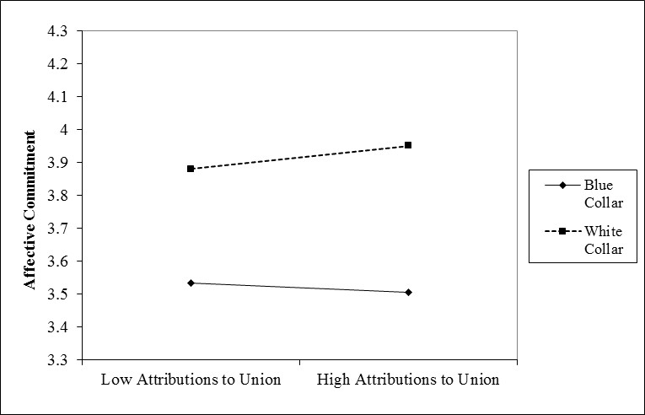
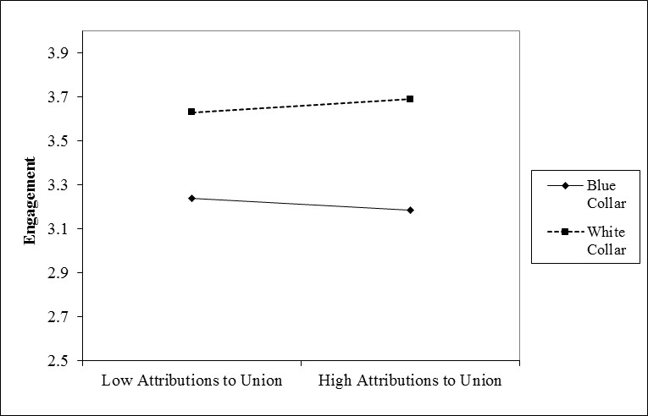
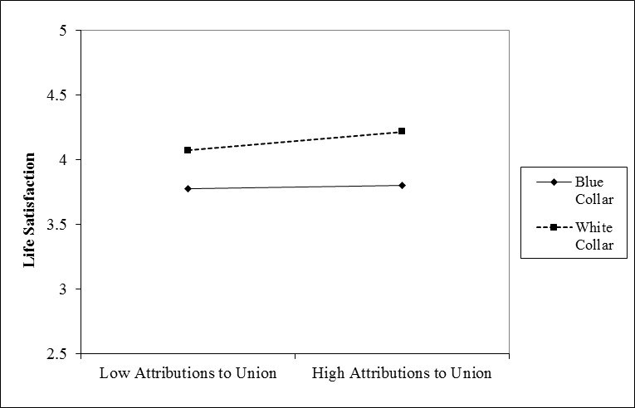
Findings – HR attributions and Employee outcomes
  Hypothesis 3a is partly supported – Attributions that HR practices have been implemented due to union pressure are positively associated with commitment, engagement and life satisfaction among white-collar workers. The negative association among blue-collar workers was unexpected.

Slide 47
Summary of Findings
Attributions to well-being and performance enhancement are significantly associated with higher employee well-being, supporting a mutual gains hypothesis
Cost control/intensification attributions are consistently associated with more negative well-being though the results are weaker
Union attributions have no impact on outcomes
There is an interaction between union attributions and job type that suggests, contrary to expectations, that white-collar workers are more likely to associate union influence with more positive outcomes while the opposite is the case for blue-collar workers.

Slide 48
Implications
The findings support the potential for mutual gains from carefully communicated and implemented HRM
The findings suggest the need to go beyond the design of practices (i.e., introducing state of the art practices) and focus on its careful implementation and communication

Slide 49
References
Bakke, E. W. (1961). The human resources function. Management International, 16-24.
Boxall, P. (1996). The strategic HRM debate and the resource-based view of the firm. Human resource management journal, 6(3), 59.
Boxall, P., Purcell, J., & Wright, P. (2007). Human resource management: scope, analysis, and significance.
Bowen, D. E., & Ostroff, C. (2004). Understanding HRM–firm performance linkages: The role of the “strength” of the HRM system. Academy of management review, 29(2), 203-221.
Chambers, E., Foulon, M., Handfield-Jones, H., Hankin, S. & Michaels E. (1998). The war for talent, McKinsey Quarterly, 3: 44-57.
Guest, D. E. (1987). Human resource management and industrial relations [1]. Journal of management Studies, 24(5), 503-521.
Guest, D. E. (1997). Human resource management and performance: a review and research agenda. International journal of human resource management, 8(3), 263-276.
MacDuffie, J. P. (1995). Human resource bundles and manufacturing performance: Organizational logic and flexible production systems in the world auto industry. Industrial & labor relations review, 48(2), 197-221.
Nishii, L. H., Lepak, D. P., & Schneider, B. (2008). Employee attributions of the “why” of HR practices: Their effects on employee attitudes and behaviors, and customer satisfaction. Personnel psychology, 61(3), 503-545.
Paauwe, J. (2004). HRM and performance: Achieving long-term viability. Oxford University Press on Demand.
Pfeffer, J. (1998). The human equation: Building profits by putting people first. Harvard Business Press.

